Slide 1
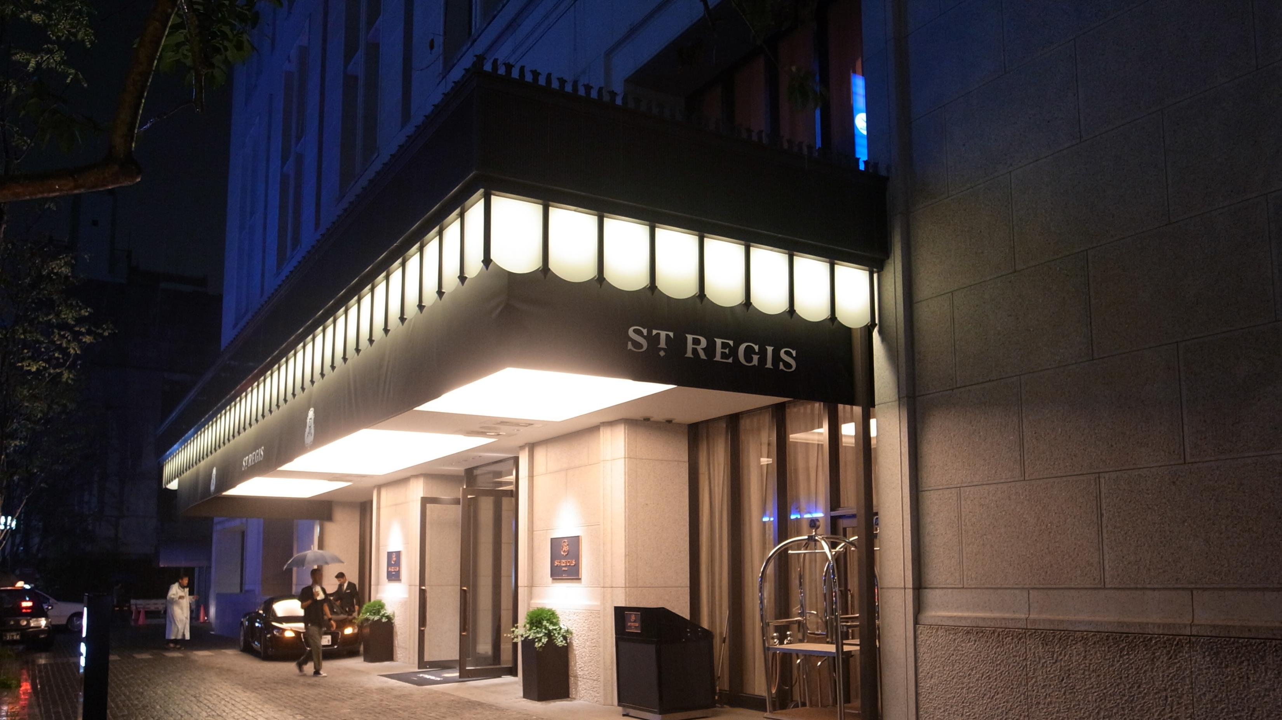
Hotel Booking Management System

Slide 2

Problem Statement
Client
Eureka Server
API Gateway
JWT Security
User
Booking Service
Payment Service
Conclusion

Slide 3
Problem Statement
To Create an Application for Hotel Booking Management System
Customer should be able to view the list of hotels, rooms available.
Customer should be able to book the rooms of the hotel.
Admin should be able to perform below operations:
1.Hotel Management
2.Rooms management
3. Payments

Slide 4
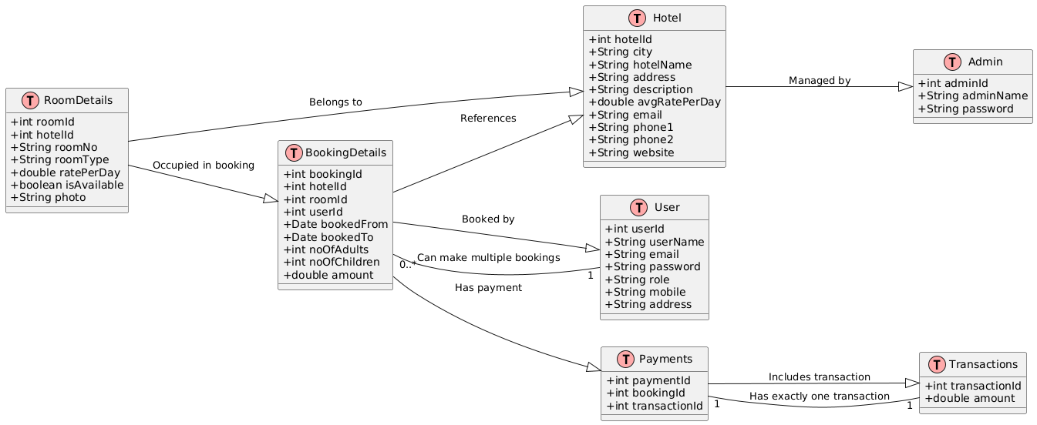

Slide 5
User
User _id : int
username : String
email :String
password :String
role : String
mobile : String
address : String
Hotel
Hotel id : int
City : String
Hotel name : String
Address : String
Description: String
rate per day: double
Email: String
Phone 1: String
Phone 2: String
Website : String
Room Details
room_ id : int
hotel _id :int
room _no : String
room _type : String
rate _per_ day : double
is _available : Boolean
photo : blob
Admin
admin_ id : Int
admin _name: String
password: String
Booking Details
booking_ id : int
hotel _id : int
room_ id : int
user _id : int
booked _from: date
booked _ to : date
no _of_ adults :int
no _of_ children : int
amount : double
Transactions
Transaction_ id : int
amount: double
Payments
payment_ id : int
booking_ id : int
transaction _id : int

Slide 6
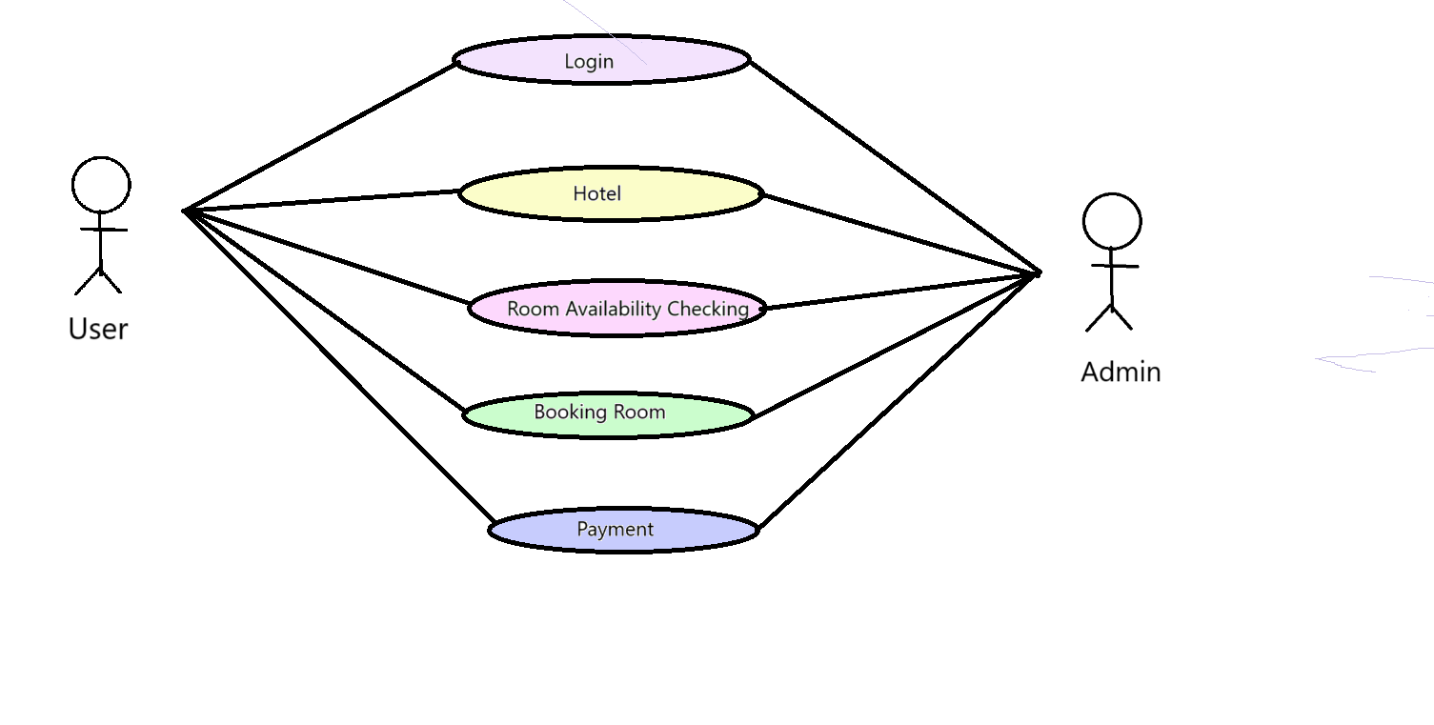
Use Case Diagram

Slide 7
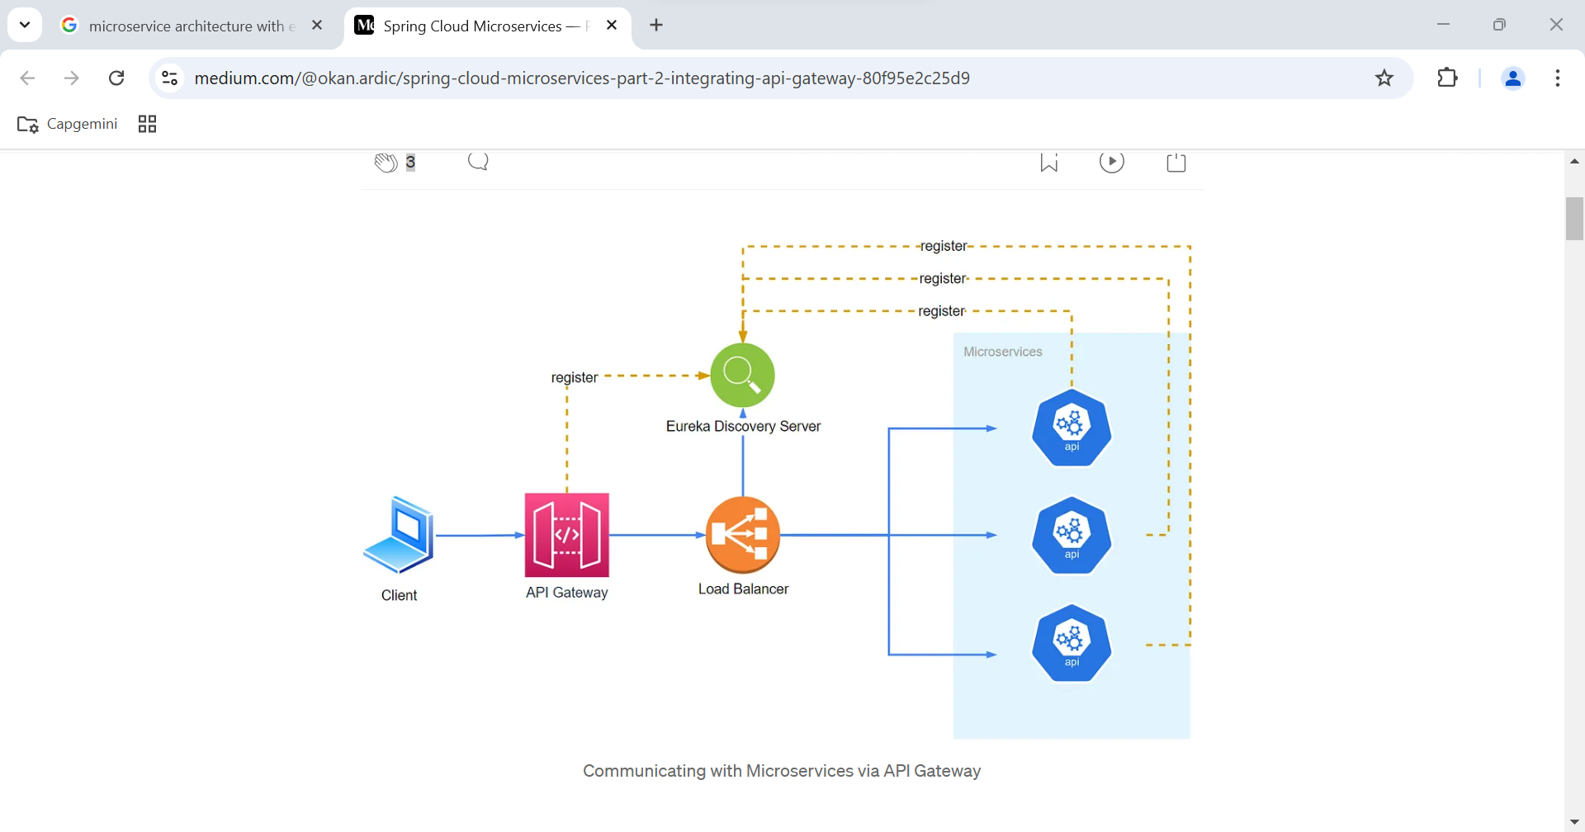

Slide 8
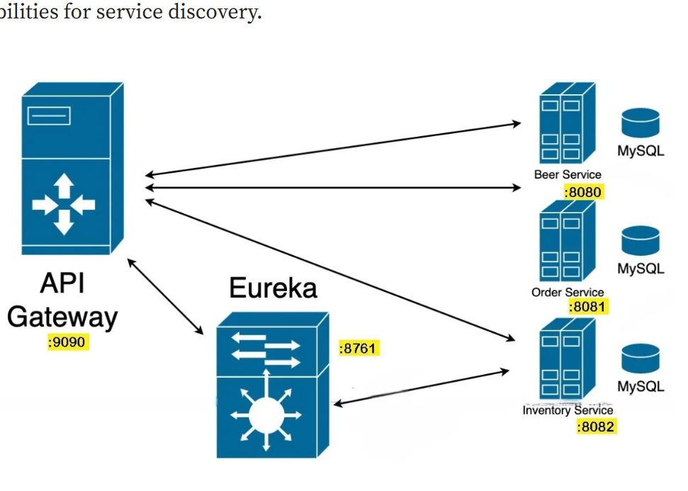

Slide 9
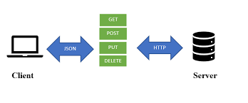

Client
In this tool, nearly any functionality that any developer may need is embedded. This tool has the ability to make various types of HTTP requests like GET, POST, PUT, PATCH, and convert the API to code for languages like JavaScript.

Slide 10
Conclusion
In Conclusion , the proposed hotel management system will bring about a significant improvement in the operational efficiency and customer experience of the hotel industry.
This system will provide a comprehensive solution of the streamlines the operational tasks .

